Slide 1
UK’s Sugar reduction and wider reformulation programme Alison Tedstone Deputy Director Diet and Obesity / Chief Nutritionist Public Health England March 2018

Slide 2
Prevalence of excess weight and tooth decay among children
The difference in obesity prevalence between boys and girls was larger in year 6 than reception.
Reception
Underweight prevalence was higher for boys in reception but higher for girls in year 6.
Year 6
The proportion of children in the healthy weight category is not shown as it would lengthen the scale making the differences for the other categories harder to see. For more information: Table 1a National Child Measurement Programme, England, 2016/17 school year.
In 2015 25% of children aged 5 years had tooth decay
In 2013 46% of children aged 8 years
34% of children aged 12 years
46% of children aged 15 years
Data from 2015/2013 dental health surveys
Notes:
The National Child Measurement Programme (NCMP) measures and records the height and weight of over one million children (aged 4-5 and 10-11 years) each year.
New data just released (2016/17) shows that 22.6% of children in Reception and 34.2% in Year 6 were overweight or obese.
Obesity prevalence in Reception has increased in the last two years and there is a long-term increasing trend in Year 6 obesity prevalence. We will analyse the trends in more detail once the full dataset becomes available.

Slide 3
UK diet compared with recommendations
Sources: National Diet and Nutrition Survey (NDNS) years 7& 8 (2014/15-2015/16)
Salt intakes: adults: NDNS: salt intakes in adults 19-64 years in England 2014; children: NDNS: years 1-4 (2008/09-2011/12)
3
Notes:
We know that poor diet has a number of consequences including overweight and obesity, cardiovascular disease, type-2 diabetes and some cancers.
This slide shows that, on average as a population, we are not achieving government healthy eating guidelines.
We consume too much saturated fat, salt and sugar, and eat too little fibre than is recommended.
Tackling poor diet is therefore key to helping people live longer and healthier lives.
Data based on year 7&8 NDNS data except for salt intakes (adult data from 2014 urinary sodium survey; child data from NDNS 2008-2012)

Slide 4
Overconsumption of calories
On average, compared with those with healthy body weights, overweight and obese children consume between 140 and 500 excess calories per day for boys and 160 and 290 excess calories per day for girls, depending on their age
Gender | Age | Overweight or obese: excess calorie intake
Boys | 4 to10 | 146
 | 11 to 15 | 498
 | 16 to 18 | 505
Girls | 4 to 10 | 157
 | 11 to 15 | 229
 | 16 to 18 | 291
Notes:
Misreporting in self-reported dietary methods is a well-documented issue and common to all dietary surveys. Underreporting may result from a number or combination of behaviours, for example omitting to record foods or drinks consumed, whether intentionally or otherwise, underestimating quantities consumed, or changing usual consumption as a result of being asked to record the diet.
Underreporting of food intake is significant and particularly pronounced in overweight and obese individuals. Thus, the proportion of the population likely to under-report increases as the population gains weight, thus exacerbating the problem of underreporting of energy intakes.
Initial analysis PHE undertook to compare Kantar reported in home purchasing data with NDNS reported in home consumption data showed that whilst there were some small differences in reporting of certain categories, they were consistent overall. This suggests that most underreporting is of out of home food consumption.
Current estimates of UK energy intakes from the NDNS show that mean reported energy intakes are 18-20% below the SACN estimated average requirements (EAR) in all age/ sex groups, except for children aged under ten years when reported figures tend to be close to the EAR.
Due to the problem of underreporting in dietary surveys an accurate estimate of calorie intake through other means is needed. This is best made through calculations using standardised equations to derive energy expenditure which is the methodology used here.
Overall, on average, adults consumed approximately 195 excess kilocalories per day, and overweight and obese adults approximately 320 excess kilocalories per day.
Excess calorie intakes have not been estimated for different socio-economic groups but given the higher prevalence of excess weight in children who live in deprived areas compared to more affluent areas it is likely that calorie excesses are likely to be similarly patterned.

Slide 5
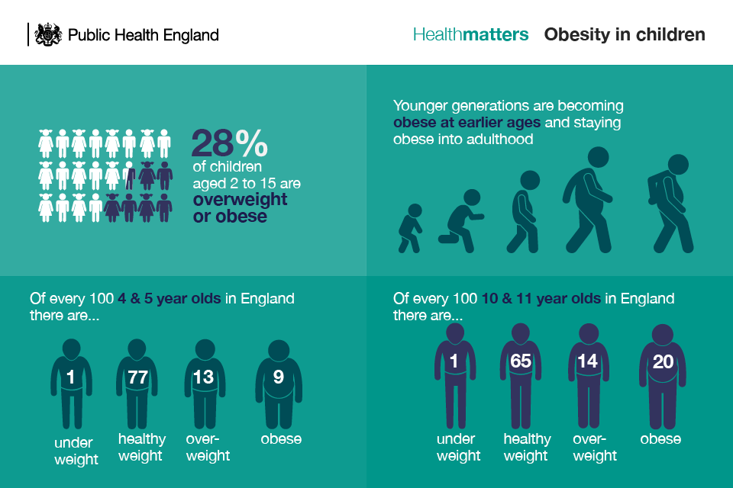
Child overweight and obesity
Body Mass Index status of children by age, National Child Measurement Programme 2016/17

Slide 6
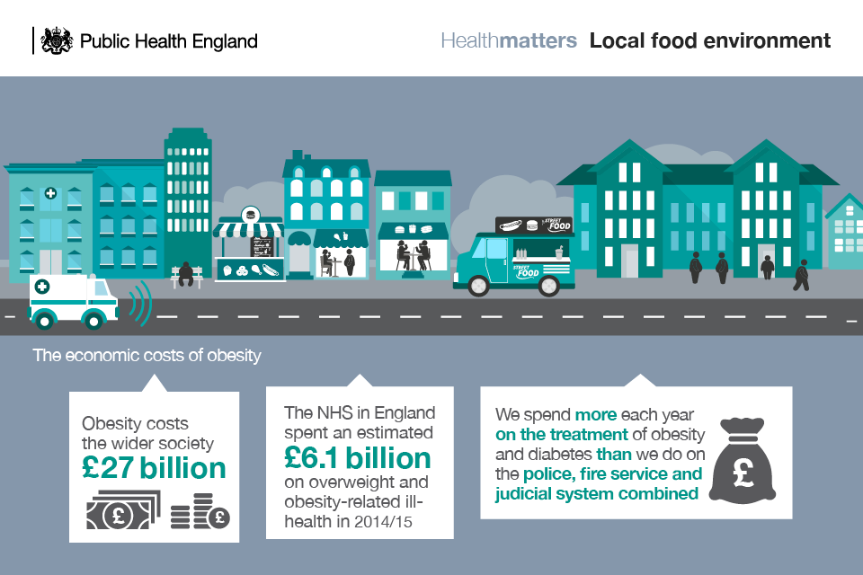
Obesity affects us all

Slide 7
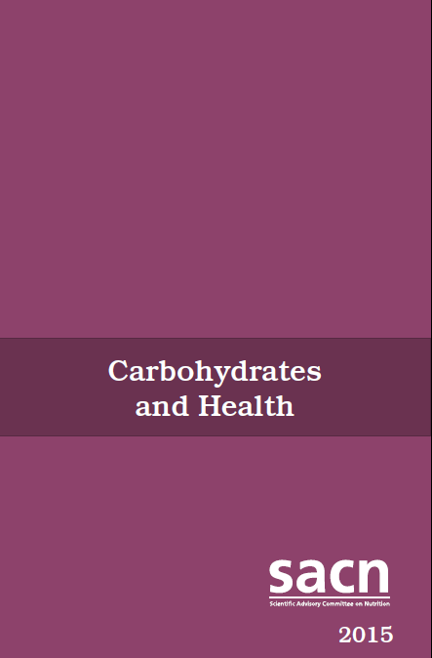
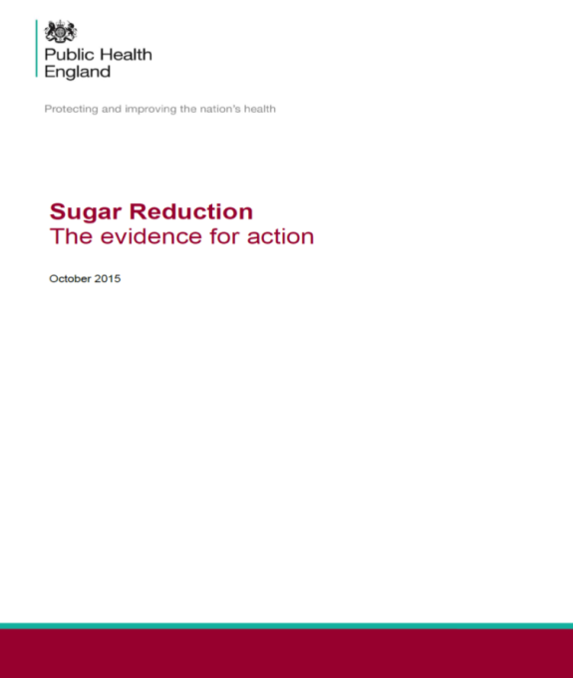
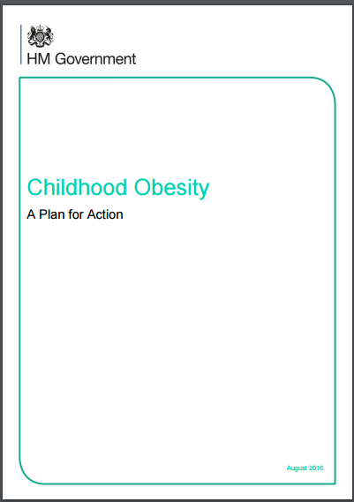
https://www.gov.uk/government/publications/sacn-carbohydrates-and-health-report
https://www.gov.uk/government/publications/sugar-reduction-from-evidence-into-action
https://www.gov.uk/government/publications/childhood-obesity-a-plan-for-action

Slide 8
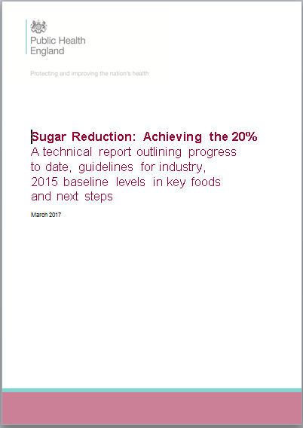
Sugar reduction: Achieving the 20%
Following ten months of engagement, on the 30th March 2017 PHE published technical guidelines for the food industry on sugar reduction. The report sets out:
The scope and approach of the programme
Guidelines for all of the food industry on total sugar levels in foods and calorie/portion size for single portions
An analysis of levels of sugar in key food categories, and soft drinks, for the year 2015
Engagement with industry, non governmental organisations and other stakeholders
Key future dates and the next steps in the programme.
The programme will also help to reduce health inequalities as sugar consumption, and rates of obesity in children, tend to be highest in the most deprived.
https://www.gov.uk/government/publications/sugar-reduction-achieving-the-20

Slide 9
Guidelines for industry: principles
Overall target is to reduce sugar by 20% by 2020 (5% reduction in year 1) through :
A voluntary programme of work giving businesses three methods to reduce the sugar in their products:
product reformulation to lower sugar levels present per 100g/ml
reduction in the portion size of, and/or the number of calories in, products that are likely to be consumed by an individual at one time. This means less sugar as well as calories and/or fat
a shift in consumer purchasing towards lower/no added sugar products
The reductions should be accompanied by reductions in calories, where possible, and should not be compensated for by increases in saturated fat.
Work to achieve the 2017 salt targets should continue alongside the sugar reduction programme

Slide 10
Taking out 20% of sugar in products
It applies to all sectors of the food industry i.e. retailers, manufactures and eating out of home sector
Category specific sales weighted average targets/100g of product were set for achievement by 2020
In addition calorie or portion size caps were set for single serve products
The programme focuses predominantly on reducing the levels of total sugars as they are declared on the nutrition panel of food labels
The guidelines have been developed for the top 9 broad food categories contributing to children’s (aged up to 18 years) sugar intake:
Breakfast cereals Puddings
Yogurt and fromage frais Ice cream, lollies and sorbets
Biscuits Chocolate confectionery
Cakes Sweet confectionery
Morning goods (buns, pastries etc) Sweet spreads and sauces (chocolate spread, peanut butter, dessert toppings/sauces & fruit spreads)

Slide 11
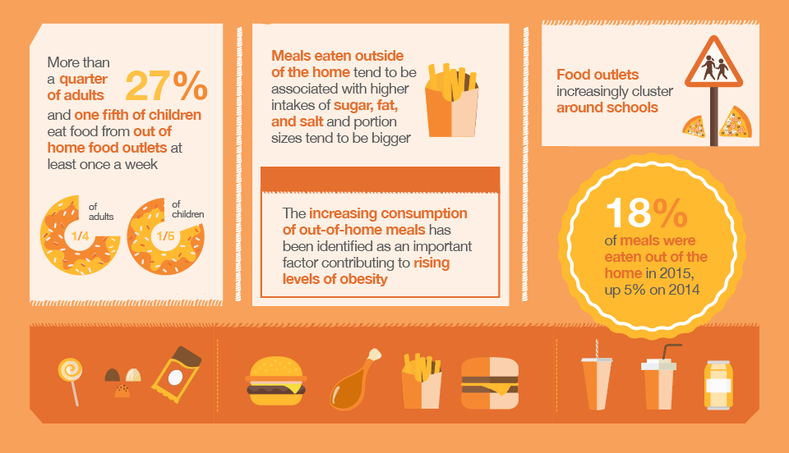
Why we need OOH involvement

Slide 12
Soft drinks industry levy
Announced March 2016, Finance Bill received Royal Assent in April 2017, comes in to law April 2018
Applies to manufacturers and importers of added sugar soft drinks and across the whole of the UK
Pure fruit juices and milk-based drinks are exempt from the levy so become part of PHE’s wider reformulation programme
The exemption for milk drinks will be reviewed in 2020, taking into account the progress made through voluntary reformulation
Two rates based on total sugar content
18p per litre for the lower sugar products (5g/100ml and above)
24p per litre for the higher sugar products (8g/100ml and above)
Created an incentive for businesses to reformulate
Revenue to be used to support schools including funding for programmes that promote physical activity and balanced diets in school-age children.
PHE is including all drinks in its monitoring programme, as requested by HMT

Slide 13
Spring 2018 progress report
Focus on individual businesses and products in case studies and tables
Baseline and Year 1 sales weighted averages for drinks within scope of the Soft Drinks Industry Levy will also be included
MCA is supplying data detailing purchases of food and drink that has been consumed out of the home for volume sales for the year ending 31 August 2017; Nutrition data has been collected by MCA from desk and field research in September/October 2017,or provided directly by businesses as of 31 August 2017
Notes:
placeholder

Slide 14
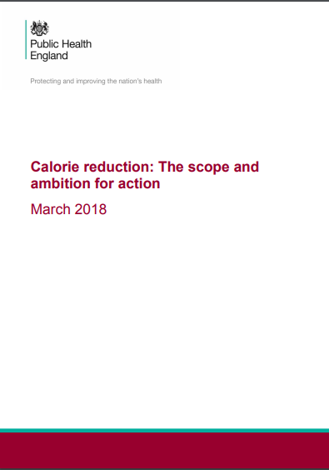
Calorie reduction: the scope and ambition for action
Published March 2018
The calorie reduction programme will account for an additional 19% of children’s calorie intakes. Together with the sugar reduction programme and the soft drinks industry levy, this will broadly account for 50% of children’s overall calorie intakes
Industry’s progress will be measured using a similar approach to sugar reduction

Slide 15
Calorie reduction ambition
20% reduction in calories by 2024, for foods where there is scope for substantial reformulation and / or portion size reduction
Savoury biscuits and crackers
Bread with additions (e.g. ciabatta with olives)
Cooking sauces, table sauces and dressings
Crisps and savoury snacks
Egg products
Potato products (e.g. chips, prepared mash, etc.)
Meat products and processed meats, poultry, fish, meat alternatives, etc. (e.g. pies, pastries, sausages, burgers, etc.)
Pasta, rice and noodles, including flavoured and filled varieties
Ready meals and meal centres, including takeaways
Dips and composite salads (e.g. hummus, coleslaw)
Pizza
Soups
Notes:
The evidence shows that there is a clear case for taking action to reduce the amount of calories that people consume. At the root of this is the fact that children and adults are consuming more calories than they require for a healthy body weight and that is leading to excess weight gain and obesity.
In developing the calorie reduction programme PHE considered information and data from a range of sources, including:
analysing data from the National Diet and Nutrition Survey, and Kantar Worldpanel data, to determine which food categories outside the sugar reduction programme were providing most calories to the diet of children up to the age of 18 years
using insights and intelligence to identify which food categories could be reformulated or portion sizes reduced and what level of reformulation was feasible and practical. Typical timeframes for product recipe changes, production and stock turn over were also considered.
PHE’s thinking on the programme was tested in a series of meetings. This initial phase of engagement with 21 industry businesses, and one non-governmental organisation (NGO) representing over 40 public health organisations, facilitated discussions on the ambition and timeline for the programme and provided a number of points for PHE to consider further. The businesses included covered all sectors of the food industry with a particular focus on the eating out of home sector and were chosen based on market share.
The calorie reduction programme aims to reduce excess calorie intakes and to contribute to reducing excess weight and obesity in children and families. It therefore applies to the majority of the population. We have, however, considered the potentially negative impact of calorie reduction measures on the general population and limited number of vulnerable groups (children (0-18 years), low weight adults (Body Mass Index (BMI) <18.5) and older adults aged 75 years and over). Data indicate that the prevalence of calorie-related under-nutrition is low in the UK. In addition, the calorie reduction programme is not intended to encourage significant energy restrictions that could result in adverse health outcomes in children or any other group of the population. It is aimed at moving energy intakes of the general population more towards current UK dietary recommendations through reductions in calories, either through reformulation or reduction in portion size, in mainly high calorie foods. It is therefore anticipated that the intended approach to calorie reduction would present a low risk of significant undernutrition in the general population.
The programme will take an approach based on sales weighted averages, meaning it will focus on the top selling, everyday products that most people buy, most of the time and the businesses that make them. These foods make the largest contributions to calorie intakes and it is paramount that industry focuses its reformulation efforts on these products and not on specific, lower calorie options which generally make up only a small proportion of sales. The sales weighted average approach means that businesses can include products above the forthcoming guidelines as long as their overall sales weighted average declines.
The eating out of home sector collectively contributes 20-25% of an adult’s energy intakes (20). It is therefore essential that this sector as a whole engages as fully as retailers and manufacturers with the reduction and reformulation programme to ensure both a level playing field and that excess calorie intakes are successfully tackled.
The UK nations recognise the need to focus on calories and the purpose of a calorie reduction programme. There has been strong support from them to date for the existing sugar reduction and reformulation programme. PHE will continue to involve the UK nations closely in the further development of the calorie reduction programme and forthcoming guidance to industry.
The baseline for the programme will be the 52 weeks ending September 2017.
The programme will not set specific menu plans or eating pattern guidance. There are other sources for this information - 5 A DAY portion sizes, the Eatwell Guide, Early years menus, Change4Life
Alcohol is considered to be outside the remit of the reduction and reformulation programme and therefore will not feature.

Slide 16
Health economic and other benefits
Based on achieving the ambition within 5 years, and outcomes spread over a 25 year period, the calorie reduction programme would:
prevent 35,370 premature deaths
save the NHS £4.5 billion in healthcare costs
save social care costs of around £4.48 billion
Assuming the SACN recommendations to reduce sugar intakes to 5% of energy intake are achieved within 10 years, the cost saving to the NHS is estimated to be about £500M per annum by year 10 (due to reductions in the costs associated with dental caries and consequences of obesity).
Notes:
Benefits are based on 20% calorie reduction in Group 1 foods (10% shift for Group 2 foods not included)
The lower fat versions of the products included in group 2 contain less saturated fat. Saturated fat intakes are currently too high in the population and the full fat versions of the products included in group 2 make a significant contribution to this. However, the lower fat versions of these same foods are lower in saturated fat which would help to lower intakes and therefore lower blood levels of cholesterol and reduce the risk of heart disease. This additional benefit has not been modelled.
Lower fat meat, fat spreads and dairy products contain similar or in some cases higher levels of some nutrients than the full fat versions (protein, iron, calcium, vitamin B12). The exception to this is vitamin A which is present in lower levels in lower fat dairy products. However, it is likely that any impact would be low as the ambition modelled is relatively small and messaging on full fat milks by young children remain valid and could be emphasised.
The estimated average number of calories reduced for the whole population is approximately 72 calories per day. Small reductions in calorie intakes, sustained over time, can help to address the significant incidence of overweight and obesity.

Slide 17
Next steps
Two phases of stakeholder engagement to inform the development of guidelines for the main product categories covered by the calorie reduction programme (June/July and Autumn 2018)
Publish guidelines for the product categories covered by the programme (mid 2019)
Publish progress report on the sugar reduction and wider reformulation programme to include the first detailed assessment of progress on the categories covered by the calorie reduction programme (March 2021)
Publish report towards the 20% (mid 2025)
The Spring 2018 report will be a detailed report monitoring progress of industry with the sugar reduction programme in Year 1 against the baseline guidelines published in March 2017
Notes:
A detailed progress report will be published in March 2018. This will include a numerical assessment of the progress made by the food industry towards achieving the 5% reduction target or the category specific guidelines
Work is underway to set guidelines for the drinks excluded from soft drinks industry levy (pure fruit and vegetable juices and high content (>75%) milk-based drinks); due to be published in 2018
Develop a calorie reduction programme – aim to publish evidence for taking action early in 2018 and product specific guidelines by end 2018
Further consideration of PHE’s programme of work on salt reduction to commence in the new year
Considerations on saturated fat will start following publication of the forthcoming draft report from the Scientific Advisory Committee on Nutrition, due early in 2018
Programme will be expanded to include product ranges explicitly targeted at babies and young children

Slide 18
Alison Tedstone Deputy Director Diet and Obesity / Chief Nutritionist Public Health England
March 2018

